Slide 1
SteamData®
Database Design, Data Integration and Application Development
Roy Koljonen September 2024
" Steam Data" is not really a registered trademark

Slide 2
Introduction
My Project Goals:
Azure Cloud Database:
Implement and maintain a cloud database for storing game data.
Back-End Development:
Develop the back-end system for managing and integrating game data with the database.
Front-End Design:
Create a web interface for users to search, filter, and view game data.

Slide 3
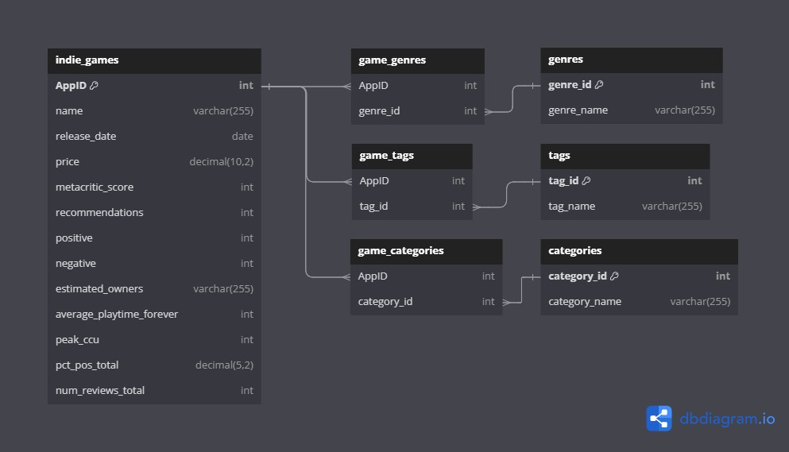
Database Table Referance Diagram

Slide 4
SQL Commands
Many-to-Many Relationships
game_tags
Table:
CREATE TABLE indie_games ( AppID INT PRIMARY KEY,
name VARCHAR(255) NOT NULL,
release_date DATE, price DECIMAL(10, 2),
metacritic_score INT,
recommendations INT, positive INT, negative INT,
estimated_owners VARCHAR(255), average_playtime_forever INT, peak_ccu INT,
pct_pos_total DECIMAL(5, 2), num_reviews_total INT
);
CREATE TABLE tags (
tag_id INT PRIMARY KEY AUTO_INCREMENT, tag_name VARCHAR(255) NOT NULL
);
CREATE TABLE game_tags ( AppID INT,
tag_id INT,
PRIMARY KEY (AppID, tag_id),
FOREIGN KEY (AppID) REFERENCES indie_games(AppID) ON DELETE CASCADE, FOREIGN KEY (tag_id) REFERENCES tags(tag_id) ON DELETE CASCADE
);
Establishes a many-to-many relationship between games and tags (same for genres and categories).
A single game can have multiple tags, and a single tag can apply to multiple games.
Example:
Game "A" with is tagged as "Indie" and
"Horror".
AppID = 1
"Indie" has , and "Horror" has
.
tag_id = 1
tag_id = 2
The table will contain:
game_tags
(AppID = 1, tag_id = 1)
for the "Indie" tag.
for the "Horror" tag.
(AppID = 1, tag_id = 2)
Foreign Key Constraints:
Ensure that each in
exists in
,
AppID
game_tags
indie_games
and each exists in
.
tag_id
tags
Cascade Deletion:
Automatically removes linked entries in game or tag is deleted.
game_tags
when a

Slide 5
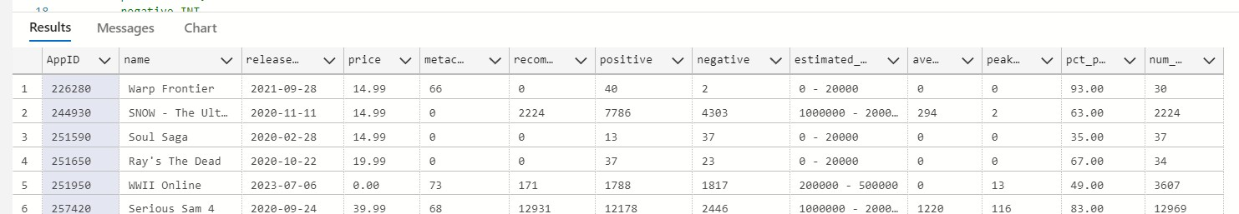
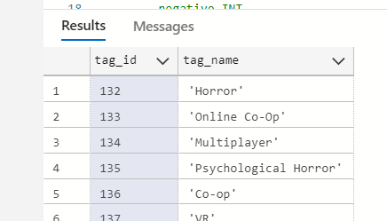
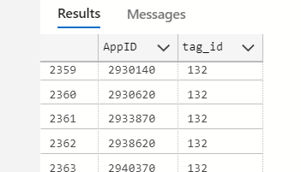
indie_games
:
tags
:
game_tags
:

Slide 6
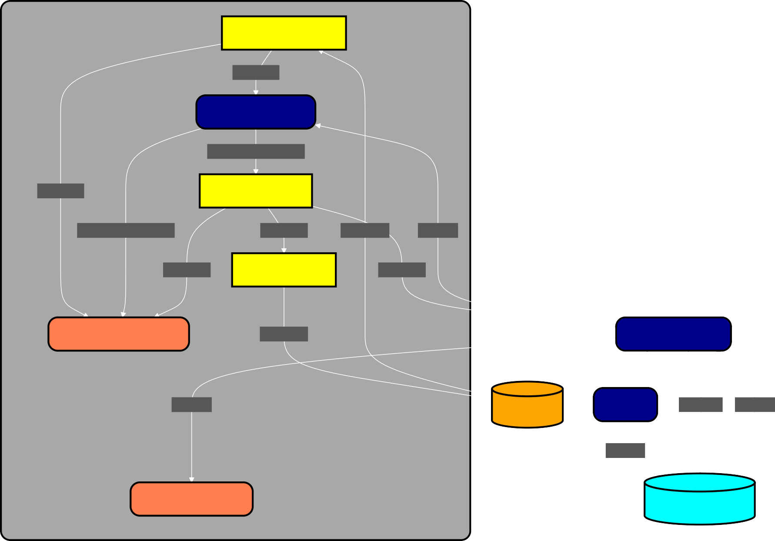
Back End Application Architecture Diagram
Key Components:
Main Form
CSV Import Module
Validation Module
Validates and compares imported data with database
entries.
Parse Data
Validation Module
Ensures there are no duplicate
entries. Cross- references tags, genres,
and categories.
Validate and Compare
Parse Data
Filtering Module
Filtering Module
Filters data before pushing to the database or exporting.
Validate and Compare
Filter Data
Import CSV
Pull Data
Filter Data
Export Module
Filter Data
Supports filtering by name, genre, tag, and date.
Prepares the final data for
upload/export.
Data View Import Data
Export CSV
Database Module
Database Module
Manages the interactions with the Azure Cloud Database.
Pull Data
Local Storage
Purge
Push Data Pull Data
Purge DB
Sends filtered data to the database in batches,
optimizing performance.
Data View DB Data
Azure Cloud Database

Slide 7
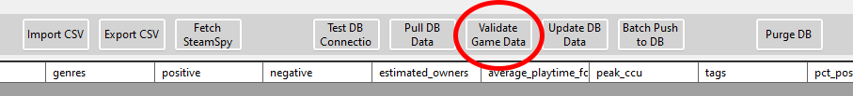
Validation Module:
Loops through imported data, validates each game, and updates the view with valid entries.
Logs progress and statistics (valid, invalid, duplicate). Basic validation by checking required fields ,
public ValidationResult ValidateGameData(Game importedGame, Game dbGame)
{
if (importedGame.AppID <= 0 || string.IsNullOrEmpty(importedGame.Name))
{ return ValidationResult.Invalid; }
if (dbGame == null)
{ return ValidationResult.Valid; }
var sortedImportedTags = importedGame.Tags.OrderBy(t => t).ToList(); var sortedDbTags = dbGame.Tags.OrderBy(t => t).ToList();
var sortedImportedGenres = importedGame.Genres.OrderBy(g => g).ToList(); var sortedDbGenres = dbGame.Genres.OrderBy(g => g).ToList();
var sortedImportedCategories = importedGame.Categories.OrderBy(c => c).ToList(); var sortedDbCategories = dbGame.Categories.OrderBy(c => c).ToList();
if (
sortedImportedTags.SequenceEqual(sortedDbTags) && sortedImportedGenres.SequenceEqual(sortedDbGenres) && sortedImportedCategories.SequenceEqual(sortedDbCategories) && importedGame.Price == dbGame.Price &&
importedGame.ReleaseDate == dbGame.ReleaseDate && importedGame.MetacriticScore == dbGame.MetacriticScore && importedGame.Recommendations == dbGame.Recommendations && importedGame.Positive == dbGame.Positive && importedGame.Negative == dbGame.Negative && importedGame.EstimatedOwners == dbGame.EstimatedOwners && importedGame.AveragePlaytime == dbGame.AveragePlaytime && importedGame.PeakCcu == dbGame.PeakCcu && importedGame.PctPosTotal == dbGame.PctPosTotal && importedGame.NumReviews == dbGame.NumReviews)
{ return ValidationResult.Duplicate; }
return ValidationResult.Valid;
AppID
Name
and comparing key fields (tags, price, reviews,
etc.) with the database.
If all fields match, it's marked as a duplicate.
Returns ,
or
status.
Valid
Invalid
Duplicate
foreach (var importedGame in importGames.ToList())
{
var dbGame = dbGames.FirstOrDefault(g => g.AppID == importedGame.AppID); var result = ValidateGameData(importedGame, dbGame);
rowCounter++;
switch (result)
{
case ValidationResult.Valid: validGames.Add(importedGame); validCounter++;
break;
case ValidationResult.Invalid: invalidCounter++;
break;
case ValidationResult.Duplicate: duplicateCounter++;
break;
}
...
}

Slide 8
Filter Module:
Retrieves user inputs for name, genre/tag, and date range filters.
Constructs a dynamic filter list based on the entered criteria:
Name filter checks for partial matches in the
private void ApplyFilters()
{
string nameFilter = txtNameFilter.Text.ToLower();
string genreTagFilter = txtGenreTagFilter.Text.ToLower(); DateTime startDate = startDatePicker.Value.Date;
DateTime endDate = endDatePicker.Value.Date;
Name
field.
var filterList = new List<string>();
Genre/Tag filter checks for matches in both the
if (!string.IsNullOrEmpty(nameFilter))
{ filterList.Add($"(Name LIKE '%{nameFilter}%')"); }
Tags
and fields.
Genres
Date filter ensures the falls within the selected range.
if (!string.IsNullOrEmpty(genreTagFilter))
{ filterList.Add(
$"(Tags LIKE '%{genreTagFilter}%'" +
$"OR Genres LIKE '%{genreTagFilter}%')"); }
release_date
Joins the filter conditions with "AND" to form the final query.
filterList.Add(
$"(release_date >= #{startDate:yyyy-MM-dd}#" +
$"AND release_date <= #{endDate:yyyy-MM-dd}#)");
Applies the filter to the (
)
DataView
gameView.RowFilter
to display matching results in the .
DataGridView
Updates the row count label with the number of visible rows.
gameView.RowFilter = string.Join(" AND ", filterList);
int visibleRowCount = gameView.Count;
rowCountLabel.Text = $"Imported row count: {visibleRowCount}";
Refreshes the list with the filtered results.
importGames
UpdateImportGamesList();
}
8

Slide 9
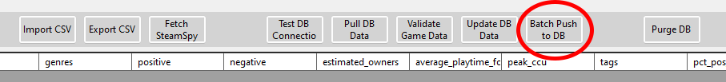
var insertGameValues = new StringBuilder(); foreach (var game in games)
{
string name = game.Name.Replace("'", "''"); insertGameValues.Append($@"(
{game.AppID},
'{name}',
// All other values
{game.NumReviews} ),");
}
if (insertGameValues.Length > 0)
{ insertGameValues.Length--; }
string indieGameInsertQuery = $@" INSERT INTO indie_games (
AppID, name,
// All other values num_reviews_total
) VALUES
{insertGameValues.ToString()} ON DUPLICATE KEY UPDATE
name = VALUES(name),
// All other values
num_reviews_total = VALUES(num_reviews_total);";
using (var cmd = new MySqlCommand(indieGameInsertQuery, connection, transaction))
{ await cmd.ExecuteNonQueryAsync(); }
await InsertCategoriesBatchAsync(games, connection, transaction); await InsertGenresBatchAsync(games, connection, transaction); await InsertTagsBatchAsync(games, connection, transaction);
await transaction.CommitAsync();
}
...
SQL Bulk Insert Logic
Bulk Query Construction:
A concatenates values for all games in the
StringBuilder
games
list, forming a bulk query.
INSERT
Optimized SQL Execution:
Executes the bulk query in one SQL command. The
ON DUPLICATE KEY UPDATE
clause updates records if they
already exist (matching ).
AppID
Transaction & Error Handling:
Wraps the entire process in one transaction to ensure all operations either succeed or are rolled back on error.
Inserting Related Data:
After games, categories, genres, and tags are also inserted into their tables in batches for efficiency.
9

Slide 10
Insert Tags (and Genres & Categories):
Get or Insert Tag:
Retrieves the tag ID from the database or inserts a new tag if it doesn't exist.
Loops through each game and its tags.
For each tag, retrieves or inserts the tag ID using
GetOrInsertTagAsync
.
Uses a dictionary to store tag IDs, minimizing repeated database queries.
Steps:
F i rs t , c h e c k i f th e ta g ex i s ts in th e c a c h e .
tagCache
Builds a bulk insert query to add tags in batches.
Executes the query to insert all game-tag pairs at once. Avoids inserting duplicate entries using
I f n o t , exe c u te a
SELECT
q u e ry to f in d th e ta g in th e
tags
ta b l e .
ON DUPLICATE KEY UPDATE
.
I f th e ta g i s fo u n d , re tu rn i ts I D.
I f n o t , in s e rt th e ta g in to th e d a ta b a s e a n d re trie v e i ts I D u s in g LastInsertedId . A d d th e ta g a n d i ts I D to th e c a c h e fo r fu tu re lo o k u p s .
private async Task InsertTagsBatchAsync(
List<Game> games, MySqlConnection connection, MySqlTransaction transaction)
{
var tagValues = new StringBuilder(); foreach (var game in games)
{
foreach (var tag in game.Tags)
{
int tagId = await GetOrInsertTagAsync(tag, connection, transaction); tagValues.Append($"({game.AppID}, {tagId}),");
}
}
if (tagValues.Length > 0)
{ tagValues.Length--; }
string gameTagInsertQuery = $@"
INSERT INTO game_tags (AppID, tag_id) VALUES
{tagValues.ToString()}
ON DUPLICATE KEY UPDATE tag_id = VALUES(tag_id);";
using (var cmd = new MySqlCommand(gameTagInsertQuery, connection, transaction))
{ await cmd.ExecuteNonQueryAsync(); }
}
private async Task<int> GetOrInsertTagAsync(
string tag, MySqlConnection connection, MySqlTransaction transaction)
{
if (tagCache.TryGetValue(tag, out int tagId))
{ return tagId; }
string selectQuery = "SELECT tag_id FROM tags WHERE tag_name = @TagName"; using (var cmd = new MySqlCommand(selectQuery, connection, transaction))
{
cmd.Parameters.AddWithValue("@TagName", tag); var result = await cmd.ExecuteScalarAsync(); if (result != null)
{ tagId = Convert.ToInt32(result); } else
{
string insertQuery = "INSERT INTO tags (tag_name) VALUES (@TagName)";
using (var insertCmd = new MySqlCommand(insertQuery, connection, transaction))
{
insertCmd.Parameters.AddWithValue("@TagName", tag); await insertCmd.ExecuteNonQueryAsync();
tagId = (int)insertCmd.LastInsertedId;
}
}
}
tagCache[tag] = tagId; return tagId;
}
10

Slide 11
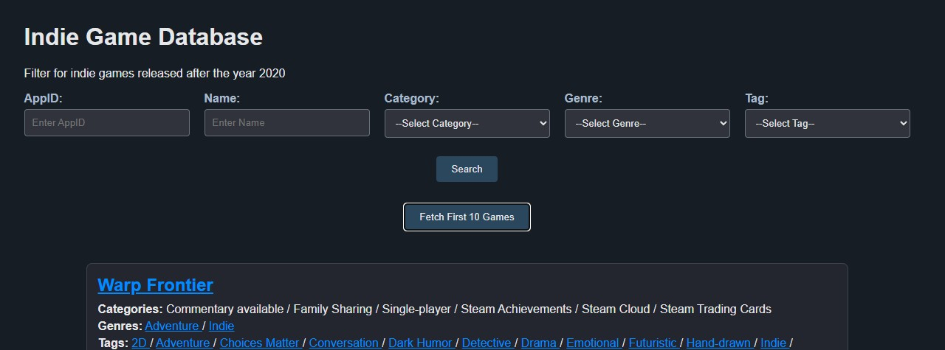
Front-End Web Design
Web Interface:
Simple design allowing users to search, filter, and view game data.
Data Presentation:
Data is presented in tables with dynamic filtering options. Individual game details for insights into specific titles.
11

Slide 12
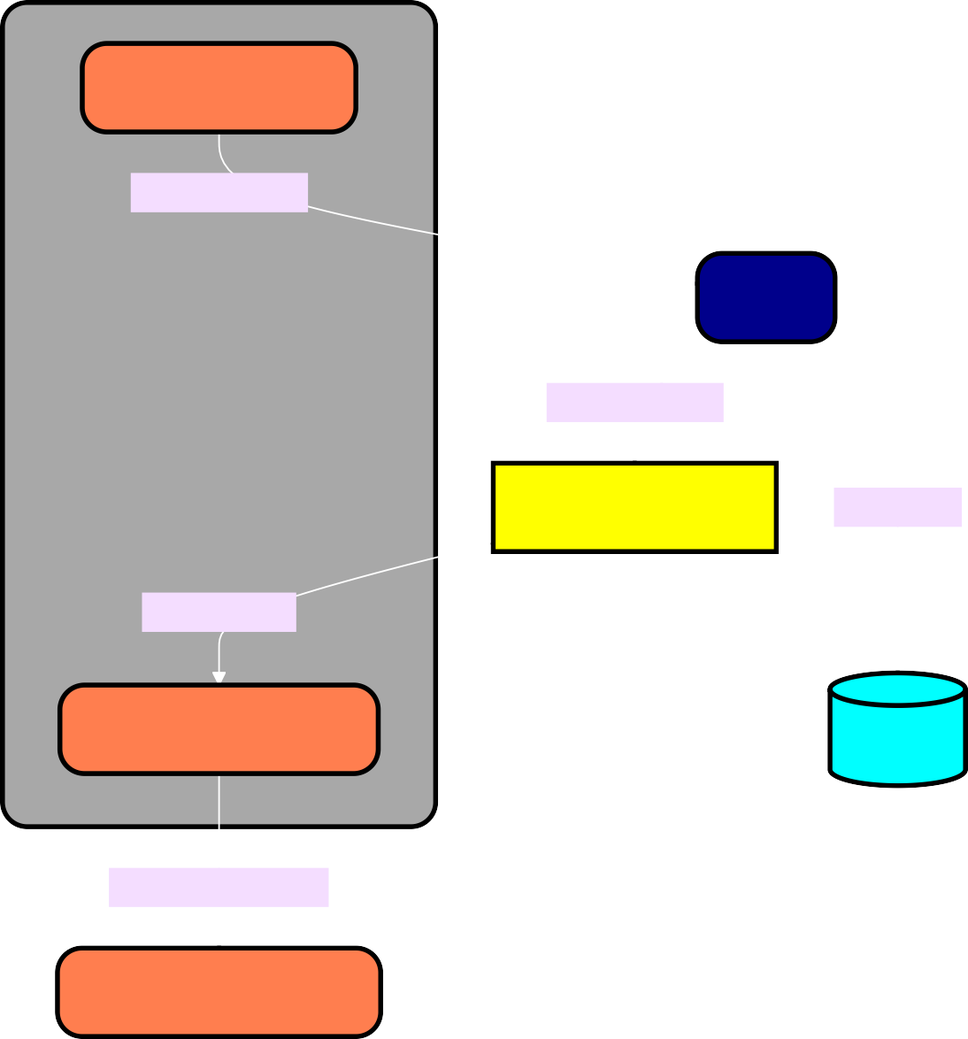
Workflow:
Front-End Web Page
User Interface
User Interface: Users search/filter games on the front-end.
Search & Filter: Filters are passed to the backend, processed by the API.
API: Retrieves data from the database based on filter conditions.
Database: Stores and fetches game data (genres, tags, etc.).
Data Presentation: Filtered results are displayed on the UI.
Game Details Page: Users can view detailed information for a selected game.
Search & Filter
API
Search & Filter
Search & Filter
Fetch Data
Filter Results
Data Presentation
Database
View Game Details
Game Details Page
12

Slide 13
HTML & Styles:
<body>
<h1>Indie Game Database</h1>
<p>Filter for indie games released after the year 2020</p>
<div class="search-grid">
<div class="grid-item">
<label for="appid">AppID:</label>
<input type="number" id="appid" placeholder="Enter AppID" />
</div>
...
<div class="search-button">
<button onclick="search()">Search</button>
</div>
...
Search fields for AppID, Name, Category, Genre, and Tags are arranged in a grid layout.
The search button triggers the
search()
function, sending user
input values for filtering.
Designed with responsive CSS grid, adjusting the layout to fit various screen sizes.
.search-grid { display: grid;
grid-template-columns: repeat(auto-fit, minmax(200px, 1fr)); gap: 20px;
margin-bottom: 20px;
}
button {
padding: 10px 20px; margin: 5px 0;
background-color: #2a475e; color: #e6e7e8;
border: none; border-radius: 4px; cursor: pointer;
transition: background-color 0.3s;
}
13

Slide 14
14

